Slide 1

AI prompting and the future of the writing industry
Emma Jones
Texas A&M University
February 18, 2025
Google images

Slide 2
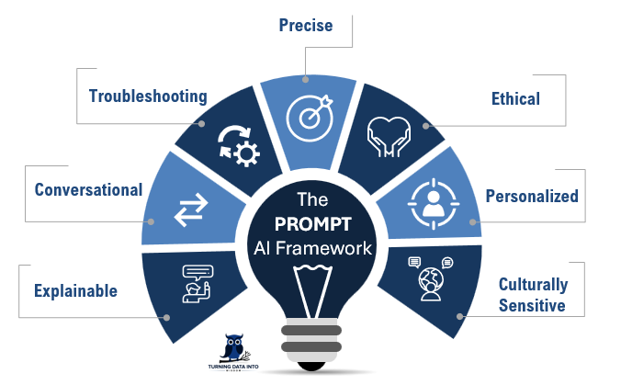
What is AI prompting?
Google images

Slide 3

Using keywords is essential
Keywords are the way to controlling
the output of AI
Google images

Slide 4
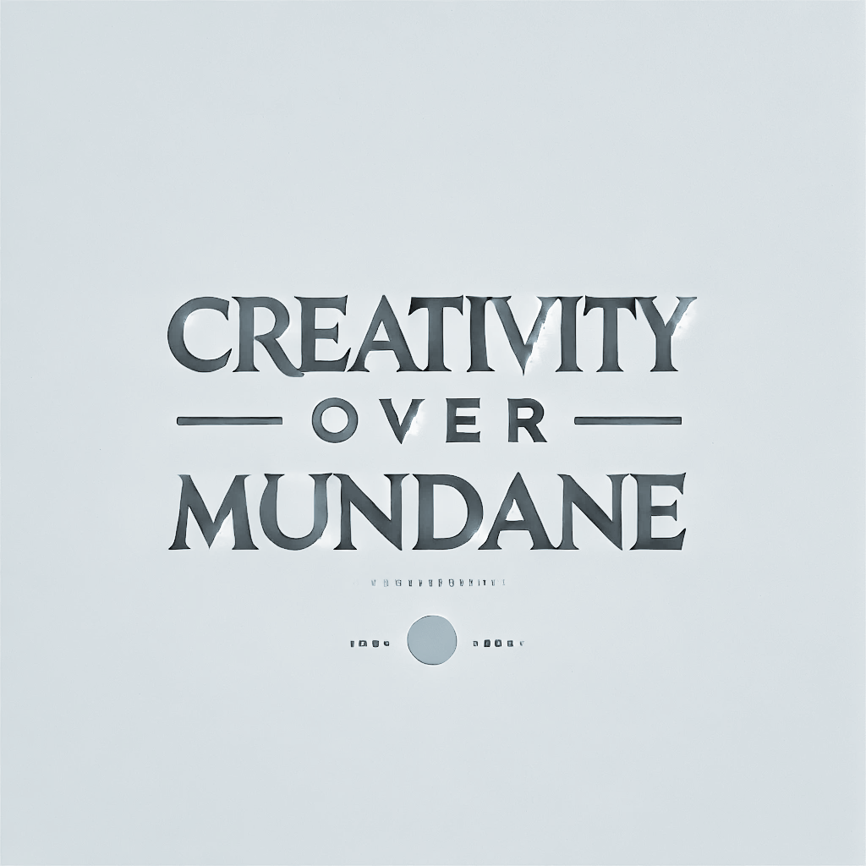
How does AI prompting change us?
Use AI to help our creativity, not
replace it
AI images

